Slide 1
What you need to know about Competition Law as a Volunteer
Simon Stokes, Partner, Blake Morgan LLP
Jill Chipchase, Head of Professional Communities, IFoA
Sarah Mathieson, Head of Research and Knowledge, IFoA

Slide 2

Agenda
Overview of Competition Law
Scenarios and discussion
Q&A
Additional support and resources

Slide 3
Competition Law: An Overview
Simon Stokes, Partner, Blake Morgan LLP

Slide 4
This presentation
What is competition law and why it is important
What it covers
Risks of breaching it
Areas of most relevance to IFoA and volunteers and groups
Steps to help avoid breaching competition law
Assess competition law risk at the outset
Practical steps
Decision tree
Scenarios and Q&A

Slide 5
What is competition law?
Competition law is about ensuring competition in markets
Competition has benefits
  Lower prices
  Better products
  Wider choice for consumers
  Greater efficiency than under a monopoly
Consumer welfare a core concern of Competition Regulators
More than 130 systems of competition law in the world – www.oecd.org/competition
Focus on this presentation UK/EU law
  UK Competition Act 1998 (Chapter I and II prohibitions); Articles 101 and 102 of the Treaty on the Functioning of the European Union (TFEU)
Competition law focuses on
Anti-competitive agreements (Chapter I prohibition UK; Article 101 TFEU)
Abuse of substantial market power (dominance) (Chapter II prohibition UK; Article 102 TFEU)
[Mergers, acts of public authorities (e.g. State Aid/subsidies)]

Slide 6
What is competition law?
Anti-competitive agreements are prohibited
Cartels (for example price fixing or market sharing agreements or understandings or agreements to exclude others from certain markets or to restrict output/supply of products – these are always serious breaches of competition law which can never be justified)
Other agreements, decisions or concerted practices (which need not be formal or in writing) which have as their object or effect the restriction of competition (unless they have a redeeming virtue such as enhancing economic efficiency)
  They can be informal understandings or coordinated conduct which allows the parties to gain a competitive advantage to the detriment of other businesses or consumers, for example by limiting how aggressively they may compete or by coordinating their behaviour
  They can include the decisions of membership bodies such as the IFoA – for example recommendations or best practice procedures
  IFoA, its members and volunteers/groups need to take competition law seriously as IFoA supported activities are likely to involve representatives of competitor firms meeting or working together

Slide 7
What is competition law?
Examples of anti-competitive agreements
Information Exchange
  The exchange of information between experts or more generally through the publication of the work of a group. Information exchange is likely to infringe competition law where commercially sensitive data is exchanged (for example current prices and/or pricing intentions, or information is exchanged about a firm's future strategy) which can then allow competitors to modify and/or align their behaviour or which otherwise adversely affects other firms or consumers
  As a general rule:
    the exchange or disclosure of future commercial intentions (especially pricing intentions and strategic information) will infringe competition law
    the dissemination of historic aggregated and anonymised data is usually acceptable since it will not generally enable parties to co-ordinate their commercial conduct
    the exchange of data that is unrelated to the factors by which businesses compete will not raise competition concerns

Slide 8
What is competition law?
Examples of anti-competitive agreements
Price (and other) signalling
  This can arise if volunteer group members use public means to indicate to the market that there is an intention to raise prices (e.g. "the IFoA advises the UK public that UK insurance premiums will have to rise by 10% in 2019")
  Recommendations as to the terms on which products are offered may also be problematic especially if they concern prices
Abuse of substantial market power (dominant position) is prohibited
Dominance is where firm has substantial market power that enables it to behave independently on the market with regard to competitors, customers and ultimately consumers
  Reduce prices to drive out competition (“predatory pricing”)
  Other tactics to exclude competitors
  Charge excessive prices or otherwise abusively exploit its position in the market

Slide 9
Breaching competition law
Breaching competition law is a serious matter
Fines or penalties or other regulatory action (e.g. a requirement to cease or modify the conduct in question)
Damages claims from aggrieved businesses and consumers in the courts
The commission of criminal offences
The disqualification of company officers
Time consuming and disruptive investigations from competition regulators whatever the final outcome of the investigation might be
Adverse publicity and reputational damage
[Anti-competitive agreements will be void/unenforceable]

Slide 10
Steps to help compliance
Think through the purpose of any meeting, collaboration, research activity, survey or information exchange at the outset
What kind of information might be shared or published and for what purpose?
Could it help align the behaviour of competitors or otherwise disadvantage other firms/market participants or consumers?
Is there a clear public benefit or consumer justification in what is proposed? If so and there still remains a competition concern then it is possible the benefits of what is proposed may outweigh the potential risks and so be "exempted" under competition law – consider taking legal advice
Decision tree at the end of these slides (and also in the guidance) is designed to be helpful in highlighting areas you should consider but it is not a substitute for legal advice

Slide 11
Steps to help compliance
Some other practical steps to take include
Agree terms of reference and the purpose and objectives of your volunteer group
Have a meeting agenda in advance, follow it (to avoid straying into risky areas) and keep minutes
Do not share future pricing or strategic information
Exchange any confidential information via the IFoA Executive rather than directly between members of your group
Anonymise collated information and aggregate the information presented so that individual firms are not disclosed nor do the firms themselves have access to information from other firms
  when conducting surveys arrange for an independent third party to conduct the survey
Keep a record of what information is exchanged
Use non-disclosure agreements (NDAs)/confidentiality agreements where appropriate.
Avoid making commercial recommendations in any project outputs

Slide 12
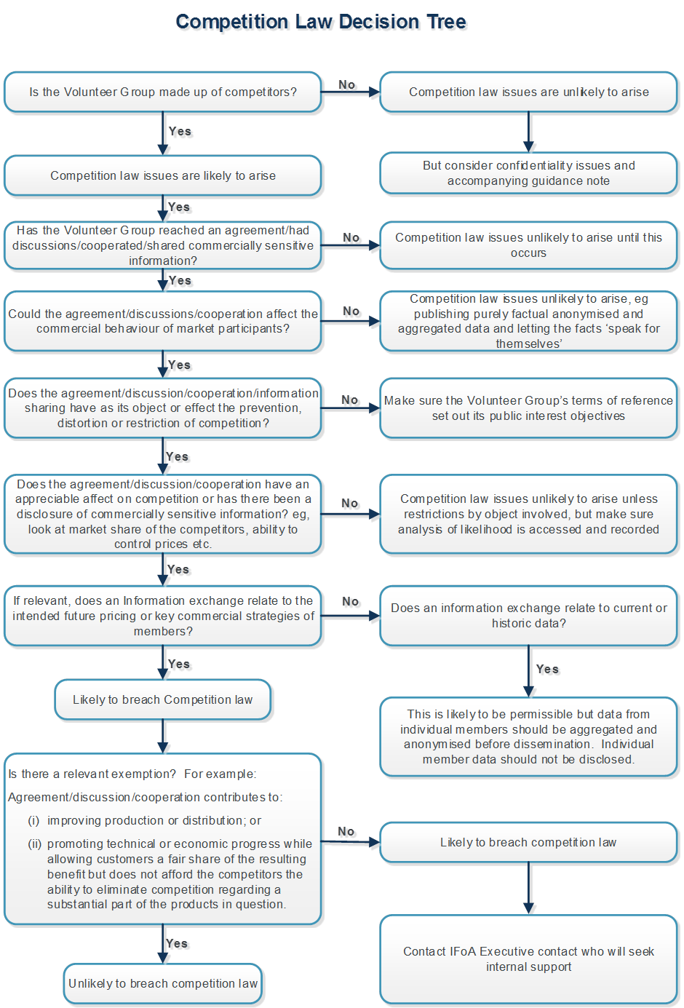

Slide 13
Competition Law Scenarios

Slide 14
Scenario 1
Working Party on Term Assurance products around the world
Who?
  Volunteer actuaries from different life assurers who do not operate in the same territories
What?
  Carrying out a study of term assurance provision in different markets
  Purpose is to understand areas of under-provision and the potential causes
How?
  Analysis of new business results from providers and regulators
  Publicly available data gathered through government-sponsored surveys
  Primary consumer research through a research agency

Slide 15
Scenario 2
Working Party supporting pre-consultation activity with a government that is considering a change to state pension age
Who?
  Volunteer actuaries from various pension providers and consultancies and an IFoA Executive staff member from the Public Affairs function
What?
  Providing opinions and insights on different increases to the state pension age and different timescales for introducing changes
How?
  Conference calls with policy makers in the relevant government department

Slide 16
Scenario 3
Scoping workshop for a new research project on the pricing of cyber insurance
Who?
  Volunteer practitioners (actuaries and non-actuaries) and academic researchers
What?
  Discussion of techniques for pricing cyber insurance for businesses
  Identifying current gaps in existing body of knowledge and limitations of techniques
How?
  Face to face facilitated meeting run behind closed doors

Slide 17
Scenario 4
Social activity after an IFoA Professionalism event hosted by a regional actuarial society
Who?
  A group of friends from different companies which cover a significant proportion of the local insurance market
What?
  Informal discussion on what is keeping them awake at night from their job:
    Difficult market conditions for new business
    Visits from the regulator challenging the capital modelling approach
How?
  Drinks and food at a local bar

Slide 18
Questions
Comments

Slide 19
Key resources and support
Competition Law Guidance https://www.actuaries.org.uk/documents/ifoa-volunteer-information-pack-competition-law-guidance
Decision tree (last page in Guidance)
Volunteer Induction Pack (VIP) https://www.actuaries.org.uk/get-involved/volunteering-ifoa/volunteer-information-pack-vip
Executive team at the IFoA – your key Executive contact is usually provided as part of your appointment letter/e-mail when accepting a volunteer position
Remember the Actuaries’ Code!

Slide 20
Thank you

Slide 21
The views expressed in this presentation are those of invited contributors and not necessarily those of the IFoA. The IFoA does not endorse any of the views stated, nor any claims or representations made in this presentation and accept no responsibility or liability to any person for loss or damage suffered as a consequence of their placing reliance upon any view, claim or representation made in this presentation.
The information and expressions of opinion contained in this presentation are not intended to be a comprehensive study, nor to provide actuarial advice or advice of any nature and should not be treated as a substitute for specific advice concerning individual situations. On no account may any part of this presentation be reproduced without the written permission of the IFoA.

